Slide 1


NOX Systems
Installation, configuration and introduction to service functions

Slide 2
Agenda
    Overview of the NOX System
    Important points
    Brief introduction of areas, users and profiles/groups
    Overview of NOX Config, the configuration software
    Practice 1: Setup Areas, Units and IO
    Practice 2: Create extra area (Area 4) move input and create slave settings
    Practice 3: Access Control setup using CMO
    Practice 4: Time Profiles setup
    Practice 5: Alarm Transmission
    Service functions on the control panel and system informations
    Conclusion, evaluation and questions

Slide 3
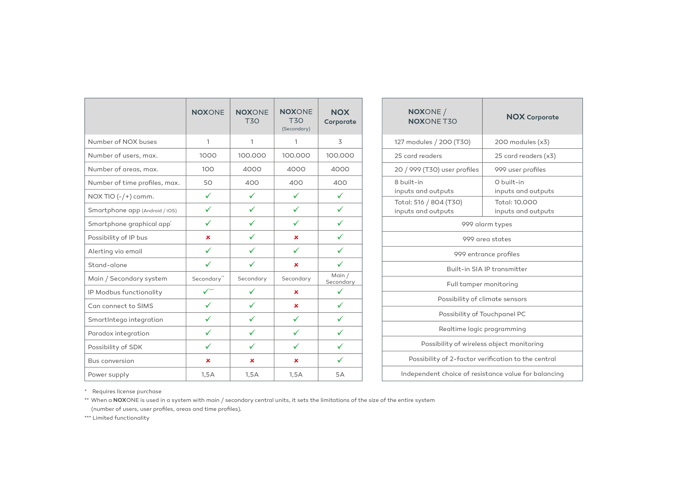
NOX versioner

Slide 4
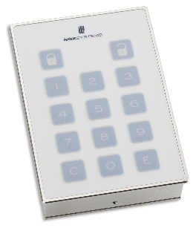
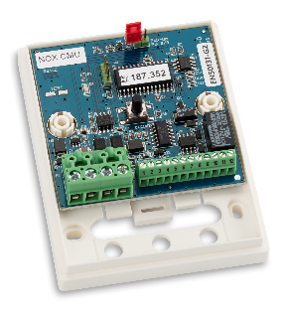
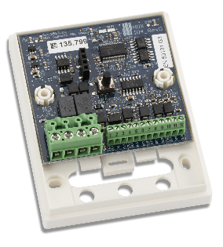
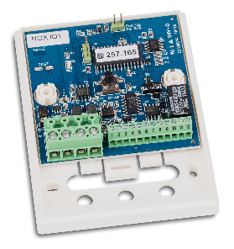
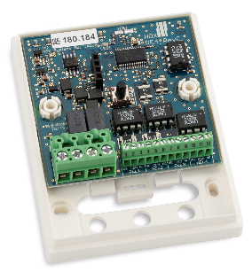
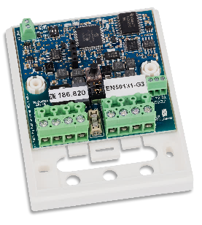
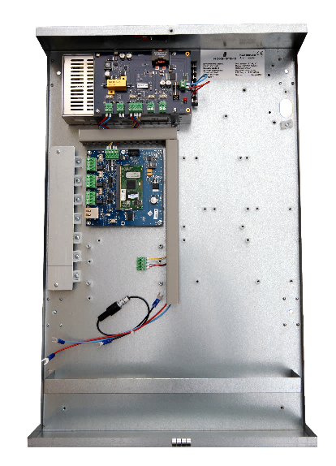
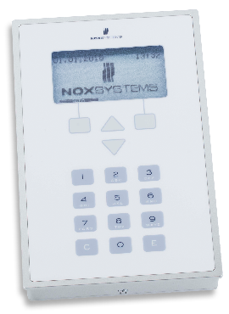
System Topology
A flexable integrated system for intrusion, access control and building management
Example of structure
CMU
IO4
THS
IO1
RE4
RPT
^{4000 areas}
^{100.000 users}
^{3 pcs. RS485 bus per central}
^{10.000 inputs per system}
^{75 doors per central}
Wireless doors, if many doors are required, use a dedicated central (20+)
^{Max. 30 gatenodes per central}
20 centrals in a networked environment
^{2 x ethernet interfaces}
CMO

Slide 5

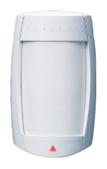
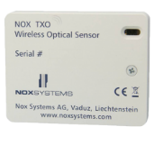
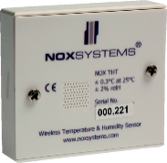
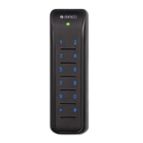
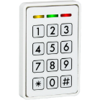
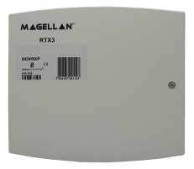
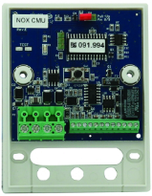

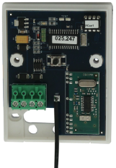
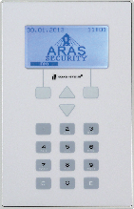
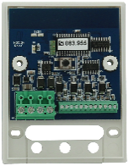
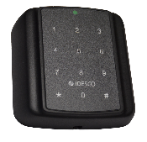

NOX
Wireless
glass break
Wireless
IR detector
Wireless
optical measurement
Wireless
temperature- and humidity sensor
Card reader
Card reader
Control panel
Card reader
Up to 127/200 modules per BUS
Water detector

Slide 6
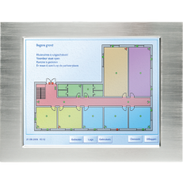
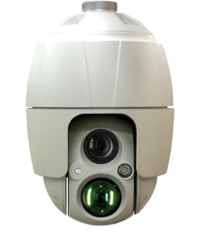
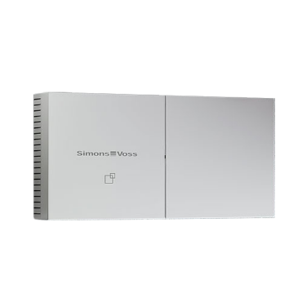



NOX
Touch-screen
VMS- Server
NOX Corporate utilizes up to 30 outgoing IP connections
IP-camera
Wireless doors

Slide 7
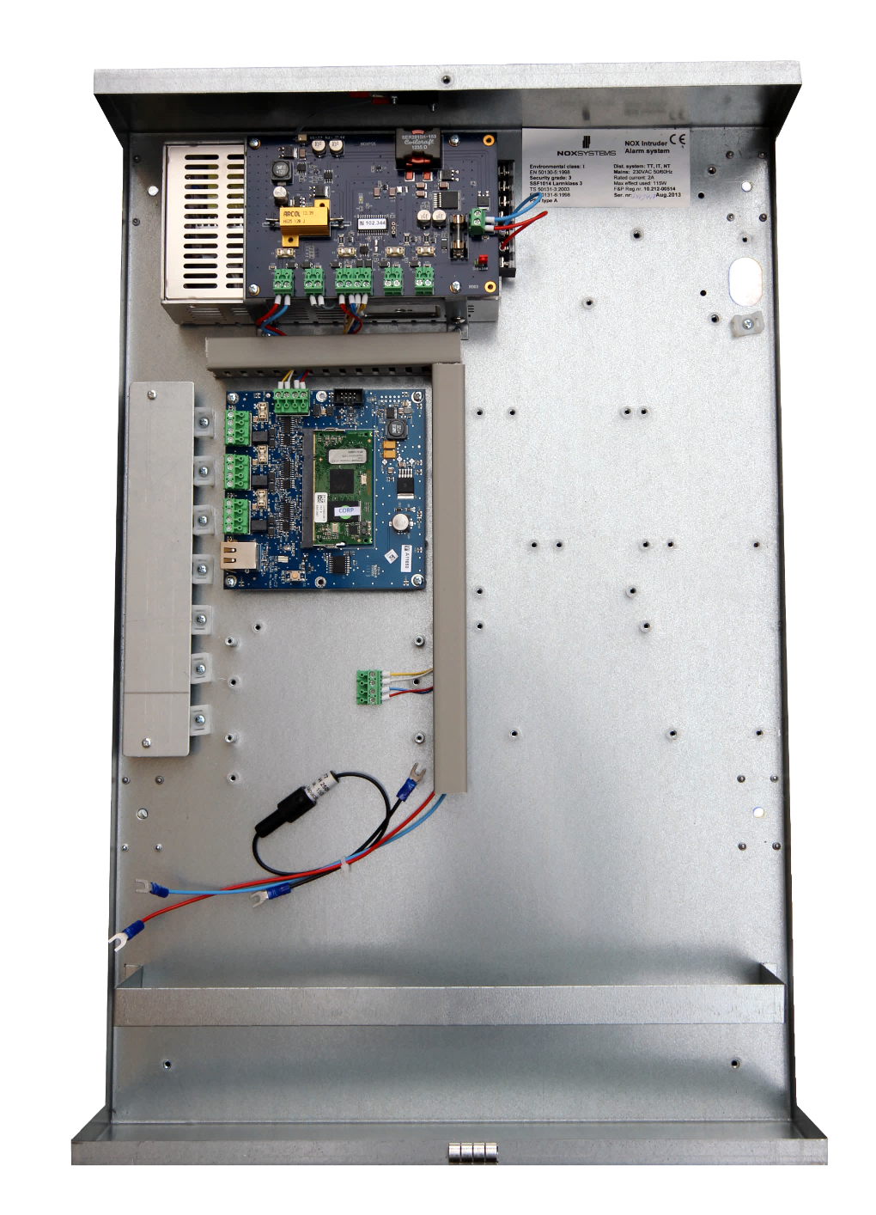
NOX Corp Central Unit
Powerfull CPU (Toradex T30)
Optical Tamper protection
PSU 5Amp w. 2 batteries, rated up to 20 AH
Extra space for 3rd party Alarm Transmission Unit, or centralized modules using NOX Module Base

Slide 8

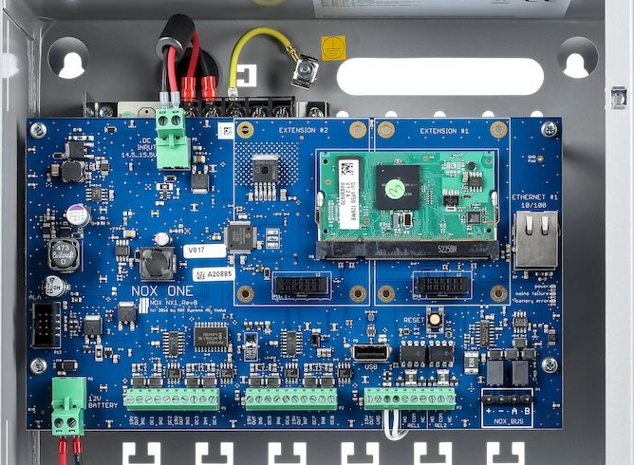
NOXONE
PIN 1,6: 15V +
PIN 2,4,7,9: Input
PIN 3,5,8,10: Output (OC)
PIN 1,2: 15V +/-
PIN 3,4: Tamper input
PIN 5 -10: Relay (2x)
Bus connection

Slide 9
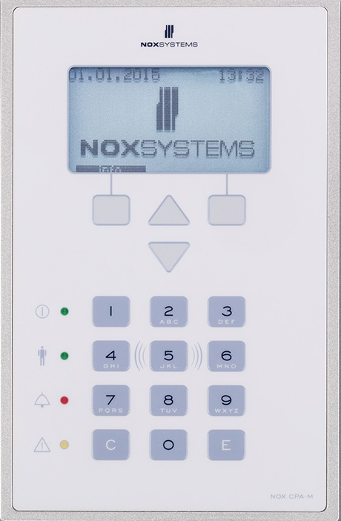
Control Panel CPA
Graphical display
ABS Plastic
Surface mount, or recessed by option
Mifare Reader as an option
4 x LED indicators

Slide 10

NOX IO4 – 4 inputs + 4 outputs
Input-/Output module w. 4 inputs and 4 OC outputs
4 Triple balanced inputs
4 open collector output, rated 100 mA each.
Output is default on, and can be programmed from NOX Config
Tamper Contact on top and an optical tamper on the back (only on IO4 G3 units)
In the NOX alarm circuit it is the V+ that is refference

Slide 11

NOX RE4 – Relay unit
4 freely programmable Relays
Solid State Relays for high performance

Slide 12
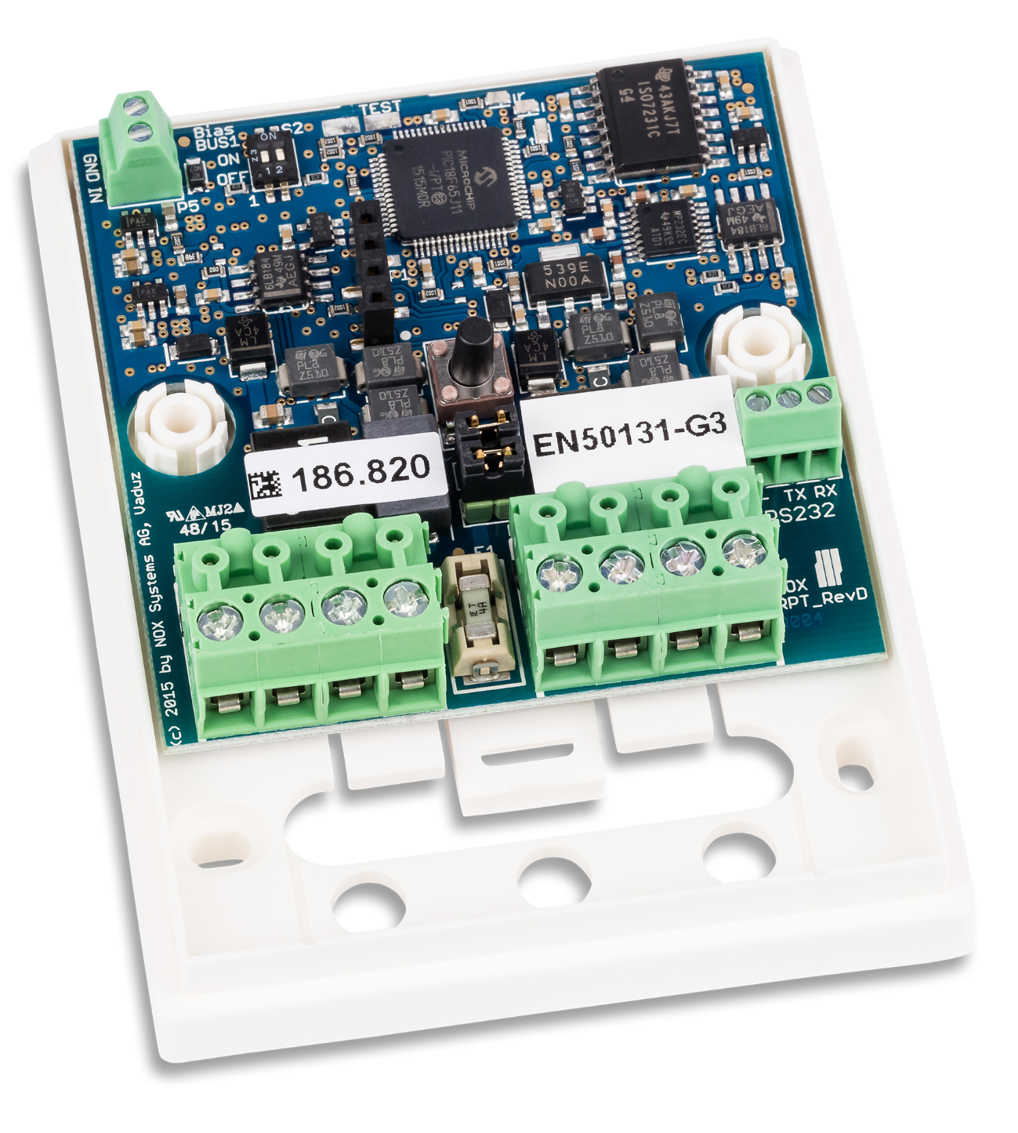
NOX RPT
Tamper Contact
RS-485 Bus extender
Allows for stubs and star connections

Slide 13
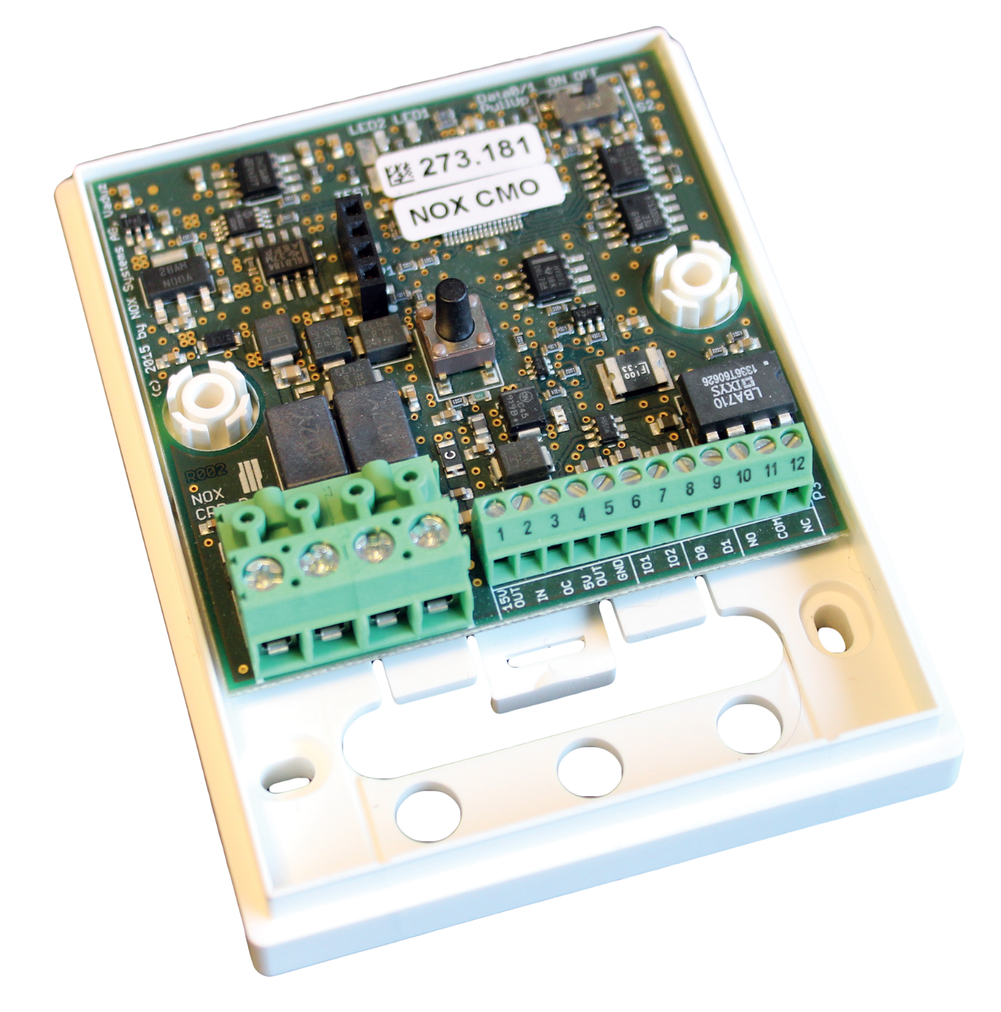
NOX CMO – OSDP unit
Card reader Unit with OSDP v2 protocol
Support for 2 readers per unit (in- and out readers)
Full programming of reader behavior avaliable
1 balanced input
1 relay for lock
Tamper Contact
TTL input for RTE – Note that TTL uses 0V/GND as reference, this is the only input on NOX units that uses this reference.

Slide 14
Important points
    EOL resistor for the BUS 120 Ω
    BUS standard is RS-485, must use TP cable! (NOX BUS Cable)
    BUS length max. 1.200 meter, can be extended with the use of RPT units (max. 8)
    No stubs without RPT, BUS must be daisy chained
    EOL resistor for inputs are default 12kΩ, but profiles for 5k6Ω, 4k7Ω exist, all inputs are triple balanced
    Programmable resistor values must be between 3,5kΩ and 50kΩ (EN50131)
    Network communication protected with AES encryption
    Log size: Alarm logs 2.000, Internal logs 2.000, User logs 6.000 (extendable on Corporate)

Slide 15
Agenda
    Overview of the NOX System
    Important points
    Brief introduction of areas, users and profiles/groups
    Overview of NOX Config, the configuration software
    Practice 1: Setup Areas, Units and IO
    Practice 2: Create extra area (Area 4) move input and create slave settings
    Practice 3: Access Control setup using CMO
    Practice 4: Time Profiles setup
    Practice 5: Alarm Transmission
    Service functions on the control panel and system informations
    Conclusion, evaluation and questions

Slide 16
NOX Areas, types and states
Alarm
On/Off
Door
System
Disarmed
On
Door Unlocked
Armed
Disarmed Exit
Off
Door Closed
Disarmed
Disarmed Exit Wait
Access Granted
Disarmed Entry
Door Held Warning
Armed
Forced Entry
Door Open
Door Held Alarm

Slide 17
NOX Areas, Create Areas
Alarm Areas
Door Areas
1. Alarm
2. Door Entrance
3. Door Gate Area 6
x. System

Slide 18
NOX Areas, Inputs/detectors
Alarm Areas
Door Areas
Inputs/detectors
IR Area 1
1. Alarm
2. Door Entrance
MC Door Entrance
IR Area 2
IR Area 3
IR Area 4
IR Area 5
IR Area 6
3. Door Gate Area 6
MC Gate Area 6
x. System
Keybox

Slide 19
NOX User Profiles
User Profiles
1. Alarm
Administrator
2. Door Entrance
Master User
3. Door Gate Area 6
Storage
x. System
Kitchen
IT

Slide 20
NOX User Profiles
User Profiles
1. Alarm
Administrator
2. Door Entrance
Master User
3. Door Gate Area 6
Storage
x. System
Kitchen
IT

Slide 21
NOX User Profiles
User Profiles
1. Alarm
Administrator
2. Door Entrance
Master User
3. Door Gate Area 6
Storage
x. System
Kitchen
IT

Slide 22
NOX User Profiles
User Profiles
1. Alarm
Administrator
2. Door Entrance
Master User
3. Door Gate Area 6
Storage
x. System
Kitchen
IT

Slide 23
NOX User Profiles
User Profiles
1. Alarm
Administrator
2. Door Entrance
Master User
3. Door Gate Area 6
Storage
x. System
Kitchen
IT

Slide 24
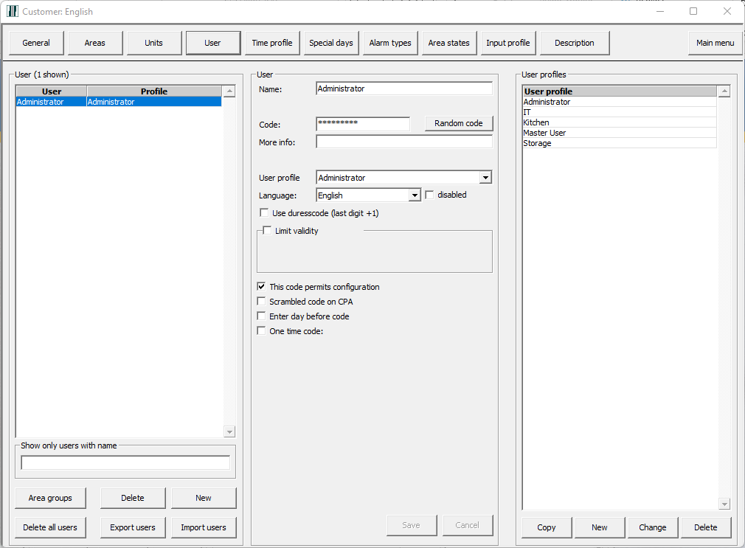
Users and User Profiles

Slide 25
Agenda
    Overview of the NOX System
    Important points
    Brief introduction of areas, users and profiles/groups
    Overview of NOX Config, the configuration software
    Practice 1: Setup Areas, Units and IO
    Practice 2: Create extra area (Area 4) move input and create slave settings
    Practice 3: Access Control setup using CMO
    Practice 4: Time Profiles setup
    Practice 5: Alarm Transmission
    Service functions on the control panel and system informations
    Conclusion, evaluation and questions

Slide 26
NOX startup
    Install NOX Config Software
    Create a new customer
    Configure your network adapter IP 10.10.11.100, Subnet 255.255.255.0
    The default IP of a NOX central is always 10.10.11.11, but it is different in training, see label on the casing
    Connect to the NOX
    Software ask if you want to create a new customer based on the configuration in the central, this is OK to do
    Open Loader, this is where you change the IP address (not allowed in training)
    NOX default IP on ETH1 is 10.10.11.11 and DHCP on ETH2
    There is one default user, Administrator, in a new configuration, you must change the code to your own preferences, in training please use 500 as code.

Slide 27
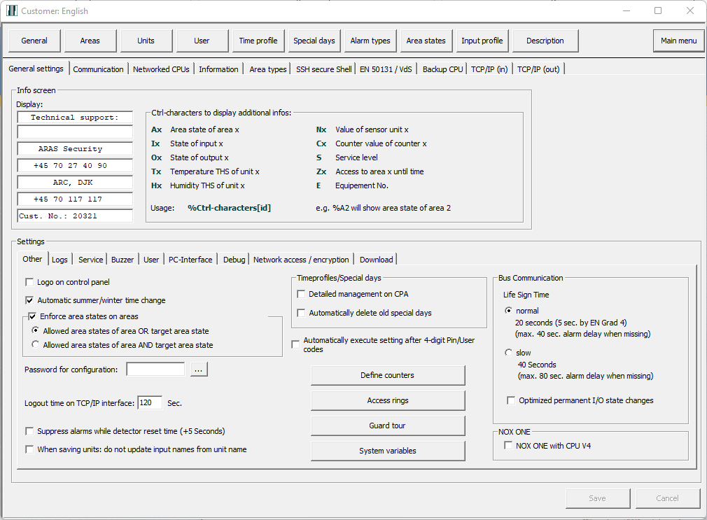
NOX Config
    Overview of NOX Config, General

Slide 28
Agenda
    Overview of the NOX System
    Important points
    Brief introduction of areas, users and profiles/groups
    Overview of NOX Config, the configuration software
    Practice 1: Setup Areas, Units and IO
    Practice 2: Create extra area (Area 4) move input and create slave settings
    Practice 3: Access Control setup using CMO
    Practice 4: Time Profiles setup
    Practice 5: Alarm Transmission
    Service functions on the control panel and system informations
    Conclusion, evaluation and questions

Slide 29
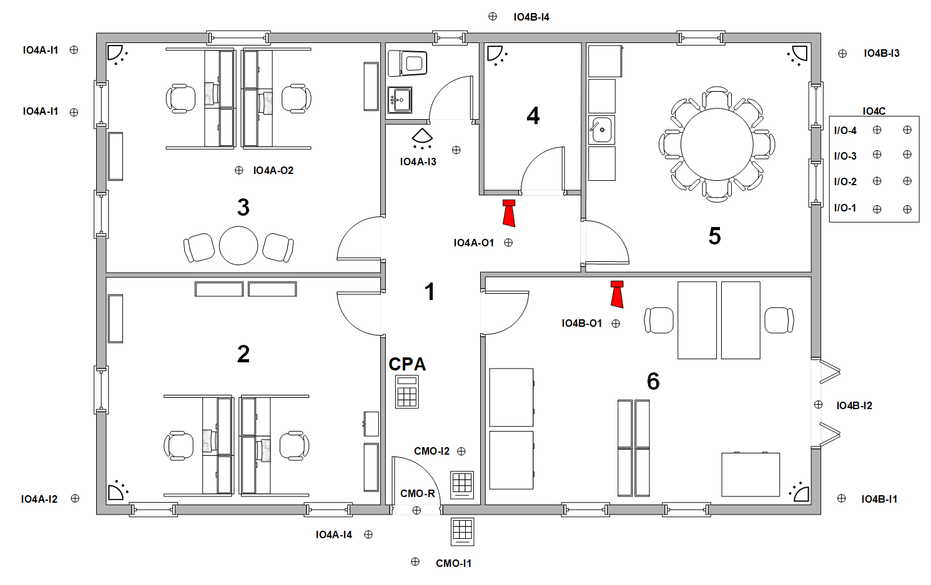
Practice 1
Description of floor plan
Create areas
CPA special setting
Create units
Configure inputs and outputs
    Areas
    1. Alarm
    2. Door Entrance
    3. Door Gate Area 6
    x. System

Slide 30
Practice 1
Description of floor plan
Create areas
CPA special setting
Create units
Configure inputs and outputs

Slide 31
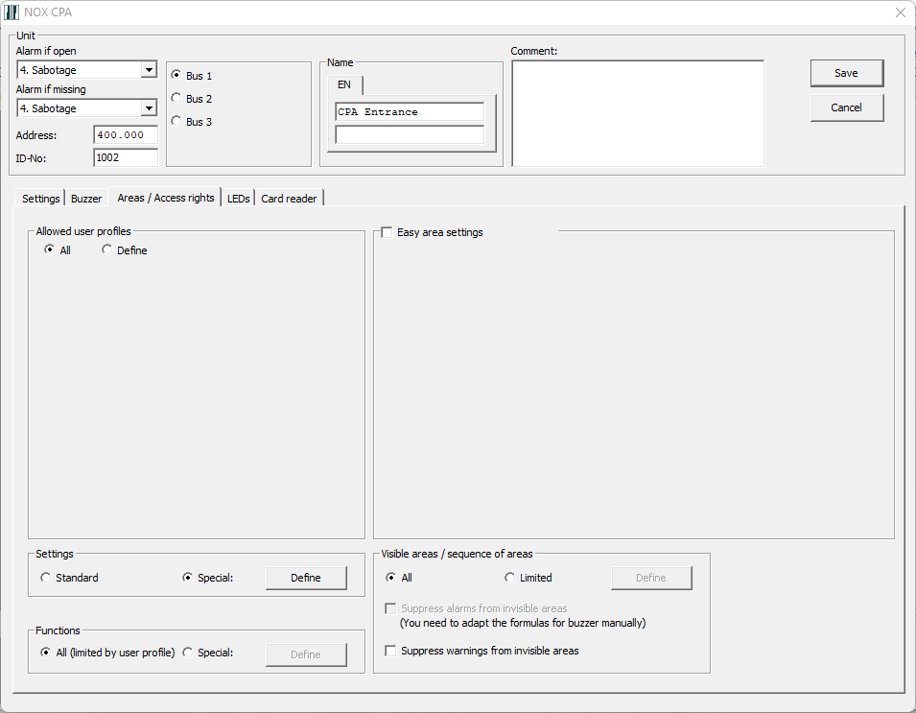
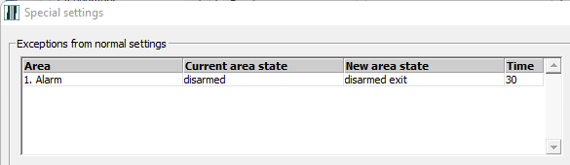
Practice 1
Description of floor plan
Create areas
CPA special setting
Create units
Configure inputs and outputs
Hand out the Configuration scheme

Slide 32
Practice 1
Install Scheme demo system 20
Address | BUS | ID-Number | Type | Input number | Area | Input name | Output number | Output name
368.171 | 3 | 3001 | PS5B |  |  | PSU Central
375.057 | 1 | 1002 | CPA |  |  | CPA Entrance
345.594 | 2 | 2003 | IO4 |  |  | IO4 A
 |  | 2003-1 |  | 1 | 1. Alarm | IR Area 3 | 1 | Siren Area 1
 |  | 2003-2 |  | 2 | 1. Alarm | IR Area 2 | 2 | Light Area 3
 |  | 2003-3 |  | 3 | 1. Alarm | IR Area 1 | 3
 |  | 2003-4 |  | 4 | X. System | Keybox | 4
345.593 | 2 | 2004 | IO4 |  |  | IO4 B
 |  | 2004-1 |  | 1 | 1. Alarm | IR Area 6 | 1 | Siren Area 6
 |  | 2004-2 |  | 2 | 1. Alarm | MC Gate Area 6 | 2
 |  | 2004-3 |  | 3 | 1. Alarm | IR Area 5 | 3
 |  | 2004-4 |  | 4 | 1. Alarm | IR Area 4 | 4
345.592 | 2 | 2005 | IO4 |  |  | IO4 C
 |  | 2005-1 |  | 1 |  | Contact 1 | 1 | LED 1
 |  | 2005-2 |  | 2 |  | Contact 2 | 2 | LED 2
 |  | 2005-3 |  | 3 |  | Contact 3 | 3 | LED 3
 |  | 2005-4 |  | 4 |  | Contact 4 | 4 | LED 4
392.519 | 2 | 2006 | CMO |  |  | Door Entrance
 |  |  |  | 1 | 1. Alarm | MC Door Entrance | 1 | Relay Door Entrance
 |  |  |  | 2 | 7. Door Entrance | RTE Door Entrance | 2
 |  |  |  | 3 |  | Disp.
6395205 |  |  | CPU
Card Code |  |  |  | 2073016546

Slide 33
Practice 1
Description of floor plan
Create areas
CPA special setting
Create units
Configure inputs and outputs
Detector Test and System Info

Slide 34
Agenda
    Overview of the NOX System
    Important points
    Brief introduction of areas, users and profiles/groups
    Overview of NOX Config, the configuration software
    Practice 1: Setup Areas, Units and IO
    Practice 2: Create extra area (Area 4) move input and create slave settings
    Practice 3: Access Control setup using CMO
    Practice 4: Time Profiles setup
    Practice 5: Alarm Transmission
    Service functions on the control panel and system informations
    Conclusion, evaluation and questions

Slide 35
Practice 2
    Create Server Room (Area 4)
    Move the input
    Create slave settings for area and door

Slide 36
Agenda
    Overview of the NOX System
    Important points
    Brief introduction of areas, users and profiles/groups
    Overview of NOX Config, the configuration software
    Practice 1: Setup Areas, Units and IO
    Practice 2: Create extra area (Area 4) move input and create slave settings
    Practice 3: Access Control setup using CMO
    Practice 4: Time Profiles setup
    Practice 5: Alarm Transmission
    Service functions on the control panel and system informations
    Conclusion, evaluation and questions

Slide 37
Practice 3
Overview of CMO settings
Overview of CMO templates
Door area: Door Entrance
Overview of User Profiles
Create a Storage User Profile
Access by Card only
Access by Card + PIN

Slide 38
Practice 3
Overview of CMO settings
Overview of CMO templates
Door area: Door Entrance
Overview of User Profiles
Create a Storage User Profile
Access by Card only
Access by Card + PIN

Slide 39
Practice 3
Overview of CMO settings
Overview of CMO templates
Door area: Door Entrance
Overview of User Profiles
Create a Storage User Profile
Access by Card only
Access by Card + PIN
Try using the template for setting:
Access with Card only if disarmed,
if armed Card + PIN,
Card + PIN also starts Diarmed Entry time.
Note that the input of the door now
is a part of the intrusion function.

Slide 40
Agenda
    Overview of the NOX System
    Important points
    Brief introduction of areas, users and profiles/groups
    Overview of NOX Config, the configuration software
    Practice 1: Setup Areas, Units and IO
    Practice 2: Create extra area (Area 4) move input and create slave settings
    Practice 3: Access Control setup using CMO
    Practice 4: Time Profiles setup
    Practice 5: Alarm Transmission
    Service functions on the control panel and system informations
    Conclusion, evaluation and questions

Slide 41
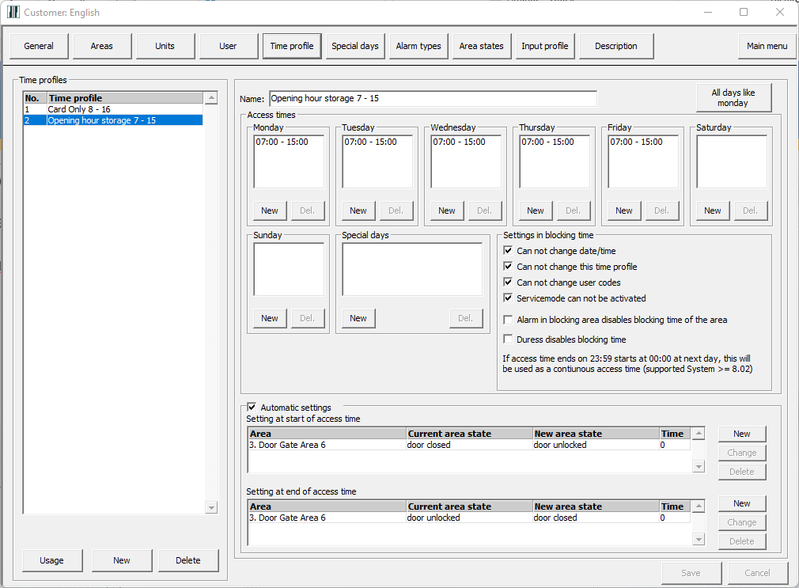
Practice 4
Overview of Time Profiles
Create a Time Profile: Card Only 8 – 16
Limit the setting on Door Entrance (CMO)
Create a Time Profile: Opening hour storage 7 - 15
Configure automatic open/close door for
Door Gate Area 6

Slide 42
Practice 4
Overview of Time Profiles
Create a Time Profile: Card Only 8 – 16
Limit the setting on Door Entrance (CMO)
Create a Time Profile: Opening hour storage 7 - 15
Configure automatic open/close door for
Door Gate Area 6

Slide 43
Agenda
    Overview of the NOX System
    Important points
    Brief introduction of areas, users and profiles/groups
    Overview of NOX Config, the configuration software
    Practice 1: Setup Areas, Units and IO
    Practice 2: Create extra area (Area 4) move input and create slave settings
    Practice 3: Access Control setup using CMO
    Practice 4: Time Profiles setup
    Practice 5: Alarm Transmission
    Service functions on the control panel and system informations
    Conclusion, evaluation and questions

Slide 44
Practice 5
Overview of ATU’s
Native:
SIA IP DC09
IP Integrated:
DALM1000 Grade 2/Niveau 20
DALM3000 Grade 3/Niveau 60
Serial (RS-232):
ESP: IRIS series, AddSecure Safetel, others)

Slide 45
Agenda
    Overview of the NOX System
    Important points
    Brief introduction of areas, users and profiles/groups
    Overview of NOX Config, the configuration software
    Practice 1: Setup Areas, Units and IO
    Practice 2: Create extra area (Area 4) move input and create slave settings
    Practice 3: Access Control setup using CMO
    Practice 4: Time Profiles setup
    Practice 5: Alarm Transmission
    Service functions on the control panel and system information
    Conclusion, evaluation and questions

Slide 46
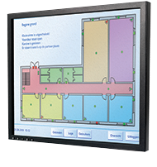
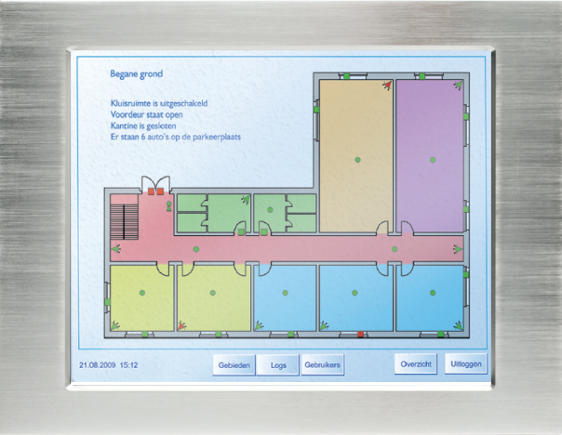

NOX
TPA Touch Screen
SIMS
iNOX Graphical Display
Add-on via one-time license pr. site

Slide 47








SIMS
SIMS
In SIMS you can use any combination of NOX central types based on the size of a given location

Slide 48








NOX integration

Slide 49








SIMS integration

Slide 50





SIMS CCTV

Slide 51

Thank you…
Find more information about NOX:
    www.aras.dk
    www.noxsystems.dk

